Slide 1
Crash, Recovery and Replication Strategy in MySQL
Hedaya Khalif, Nada Elkelani, Melissa Tran
The University of Western Ontario
Department of Computer Science

Slide 2
Background Info
Different Kinds Of Replication
Asynchronous
Master servers do not have to wait on the slave to completely catch up for the database to continue to grow
Synchronous
Master server waits on the slave servers as data is not shown in the master until all the data has been successfully replicated over to at least one slave, with no replication lag.
Permissions:
Allows the slave user to connect and receive updates from the MySQL master server’s binary logs.

Slide 3
Background Info
Types of Replication Strategies:
Master – Slave
Master – Master
Multi – Source

Slide 4
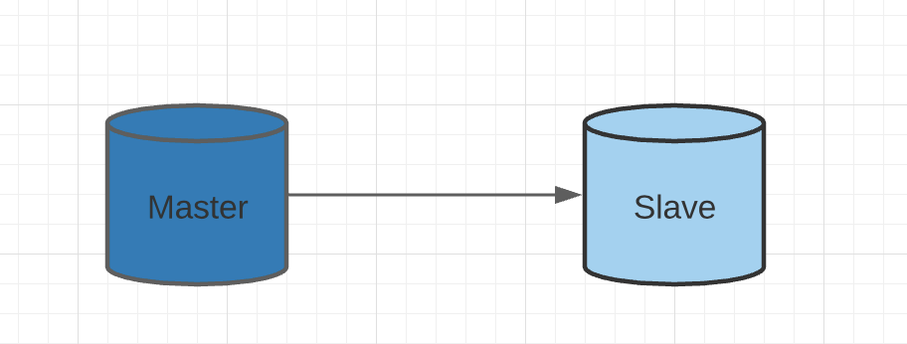
Background Info
Master – Slave Replication:
Consists of one master and one slave
If the slave writes into databases replicated from the master, problems may occur
When slave writes, data will technically exist in the master but will not be visible

Slide 5
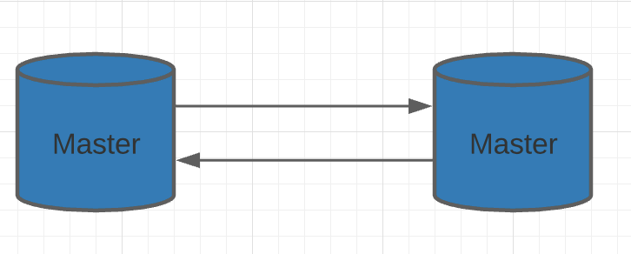
Background Info
Master – Master Replication:
No slave, and two masters
Both servers are replicated from one another and writing can be done from both ends

Slide 6
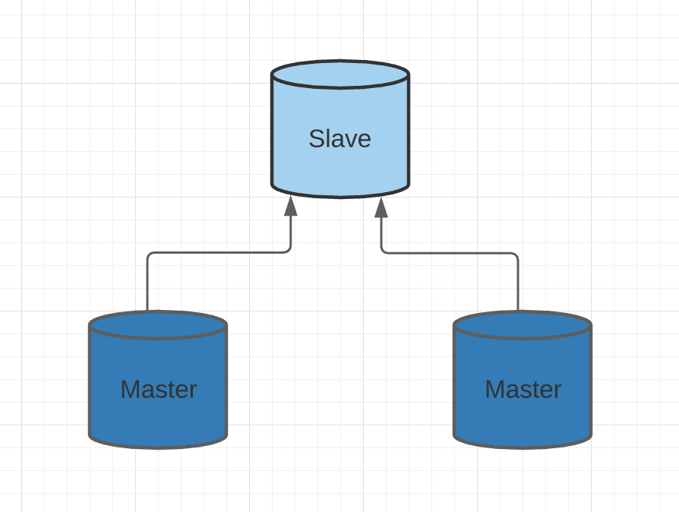
Background Info
Master – Source Replication:
One slave can be connected to multiple masters

Slide 7
Background Info
Recovery:
Error will be displayed in the MySQLl ‘show slave’ command beside the ‘last error’ variable
Error logs show reasons as to why replication is broken , allows for a rebuild and recovery plan
Command to repair replication: SET GLOBAL SQL_SLAVE_SKIP_COUNTER = 1

Slide 8
GOALS AND OBJECTIVES
The goal of this report is to learn how to set up replication in a MySQL DBMS and to test out different replication strategies. We will record observations and reflect on how they react to different updates and inserts of data. We will be testing out three different replication strategies; master - slave, master - master and multi - source replication.

Slide 9
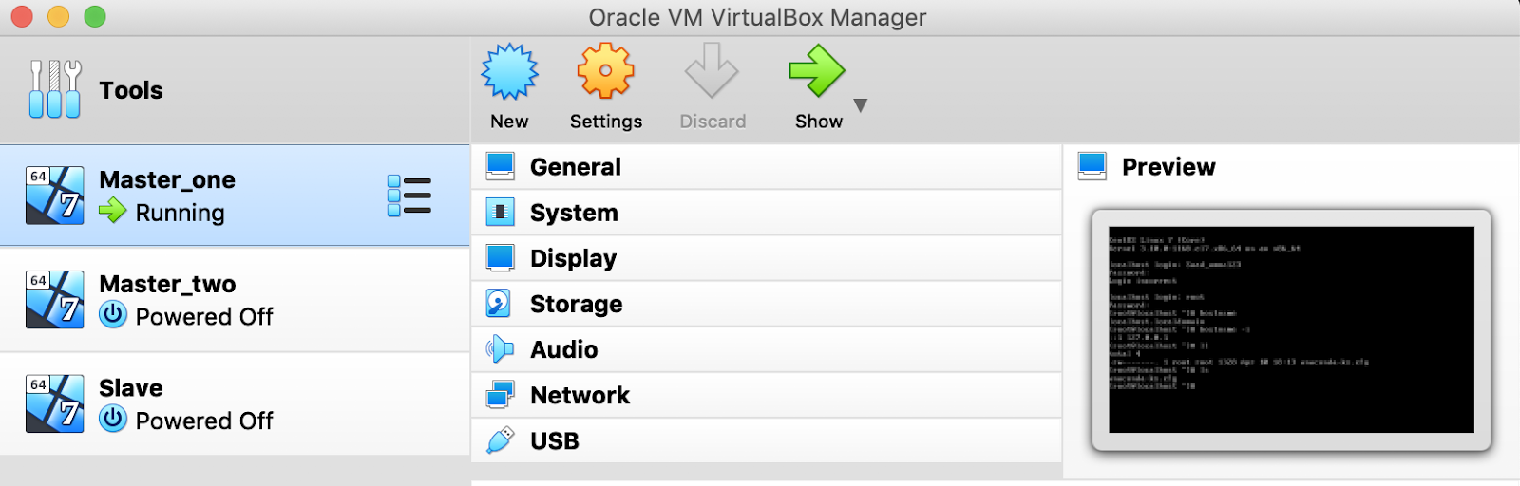
Setting up the environment
Three virtual machines using Oracle VM VirtualBox Manager
Two master servers, and one slave server
Each installed CentosOS 7 and MySQL version 5.7
Two separate network adaptors have been set up for each virtual machine, one bridge adapter and one host-only adapter in order for the virtual boxes to be able to connect to one another

Slide 10
Creating the database
Two Databases Used:
Master_one, database ‘Students’
Master_two, database ‘Courses’

Slide 11
Setting up replication
Master_one – Slave Replication
Step 1: Make sure replication user in which Slave uses to read from Master_one exists
Step 2: Take a backup of the database ‘Students” found in Master_one
Step 3: Copy over the backup file in Master_one to Slave using scp
Step 4: Begin process of restoring the data into Mysql
Step 5: Ready to set up replication!

Slide 12
Setting up replication
Master_one – Master_two Replication
Step 1: mysqldump backup file was created in order to establish the replication, taking a full backup of databases in Master_one
Step 2: Two change master commands were created to be executed in both Master_one and Master_two
Step 3: Replication is ready!

Slide 13
Setting up replication
Master_one – Master_two – Slave Replication
Step 1: Two mysqldump files were created from the master servers for databases students and courses
Step 2: Mysql users with replication slave privilege were also created in both Master_one and Master_two
Step 3: Because the slave server has two masters, MySQL needs to be able to differentiate the two
Step 4: Ready to set up replication!

Slide 14
TESTING
Test 1:
Insert data into Master_one.
Result:
Data was now visible in the slave and Master_two as shown by displaying the count number in database

Slide 15
TESTING
Test 2:
Insert data into slave.
Result:
Number of records in both the master servers did not change, as the data is not visible to be read by the masters.

Slide 16
TESTING
Recovering From Test 3 Error:
The error displays a duplicate entry on the primary key.
There is only one duplicate entry, so we are able to skip over this transaction as recorded in the binary logs.
To fix use command,
SET GLOBAL SQL_SLAVE_SKIP_COUNTER = 1

Slide 17
Conclusion

Slide 18
THANK YOU!

